Slide 1

Bookify
By: Husi Kristóf Brautigam Ricsi Erdei Tamás

Slide 2


Why did we build this?
The Problem Manual appointment scheduling, missed bookings and inefficiencies.
Solution Web-based system for automated scheduling
Target Users Service providers Customers

Slide 3
Key Features
User Registration/Login
User Friendly Interface
Appointment Scheduling
Real-time Rating System
Up To Date Calendar
Image Uploading
Responsive Design

Slide 4
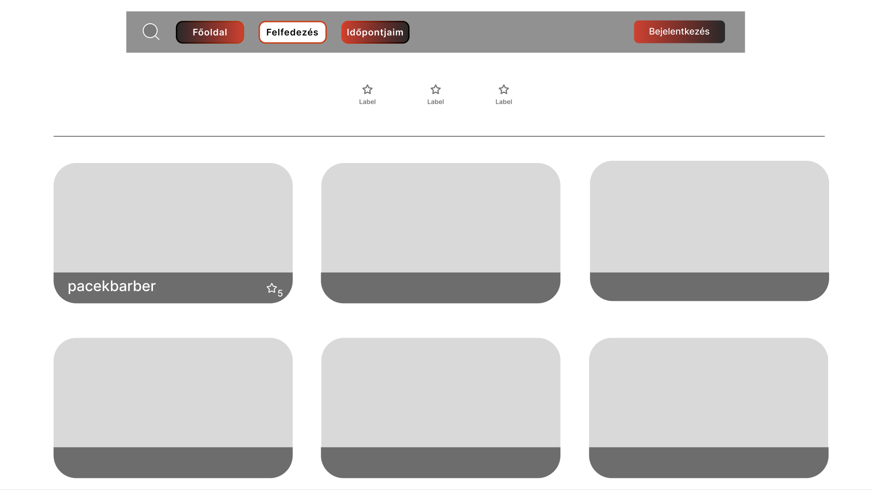
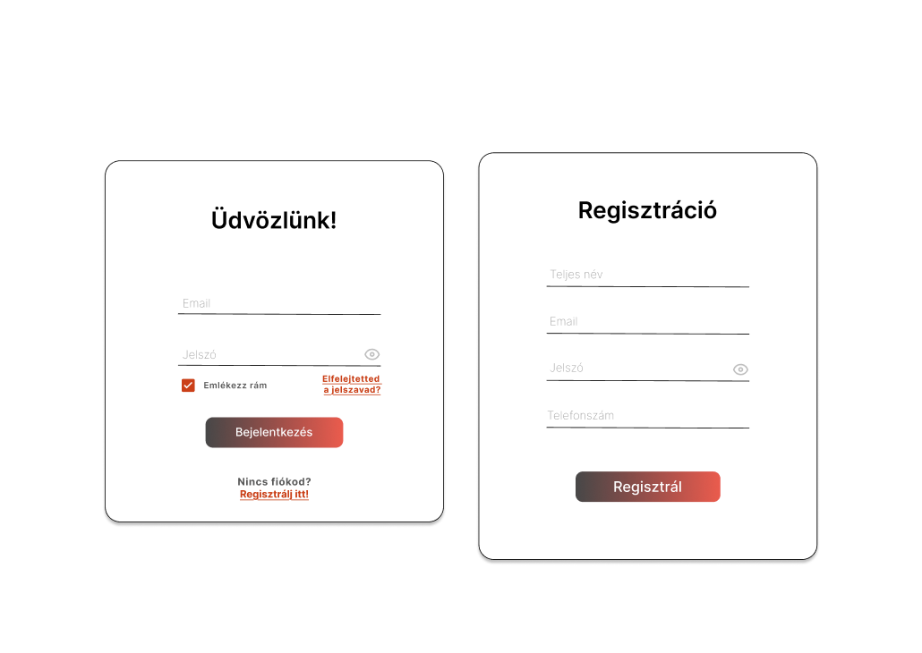
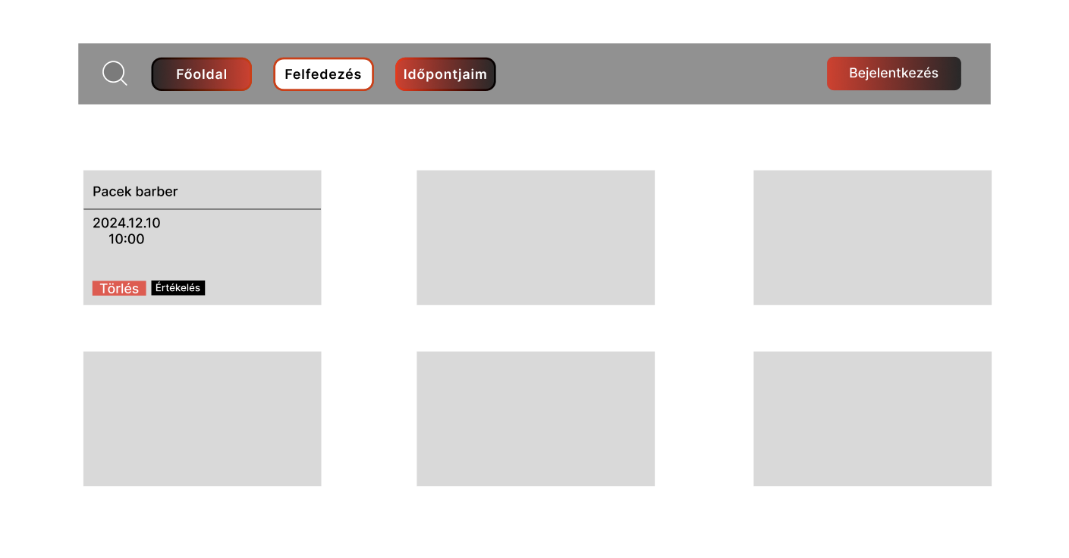
Design & Mockups
Responsive design (desktop & mobile) Dark/Light mode support Simple navigation

Slide 5
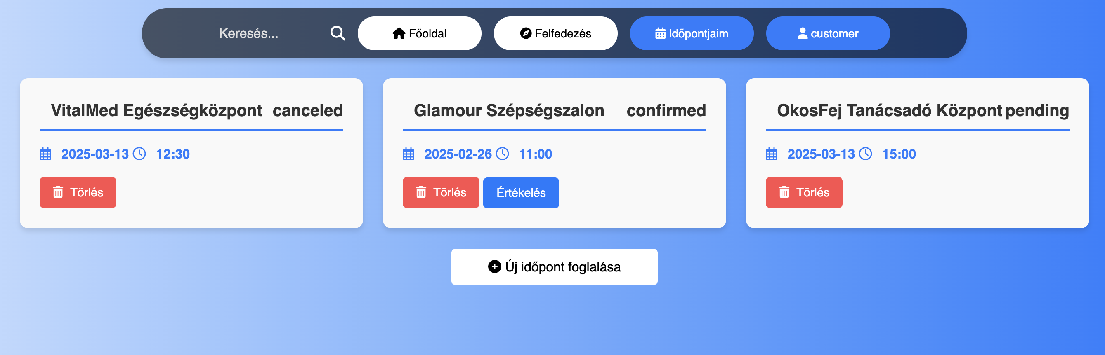
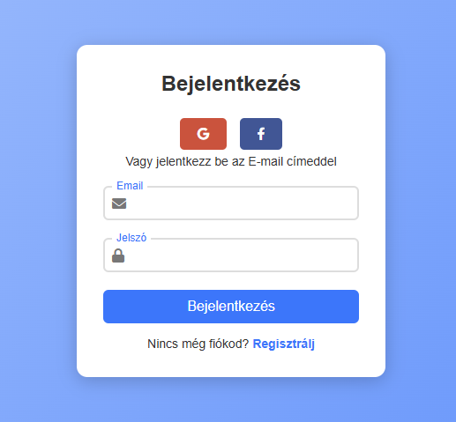
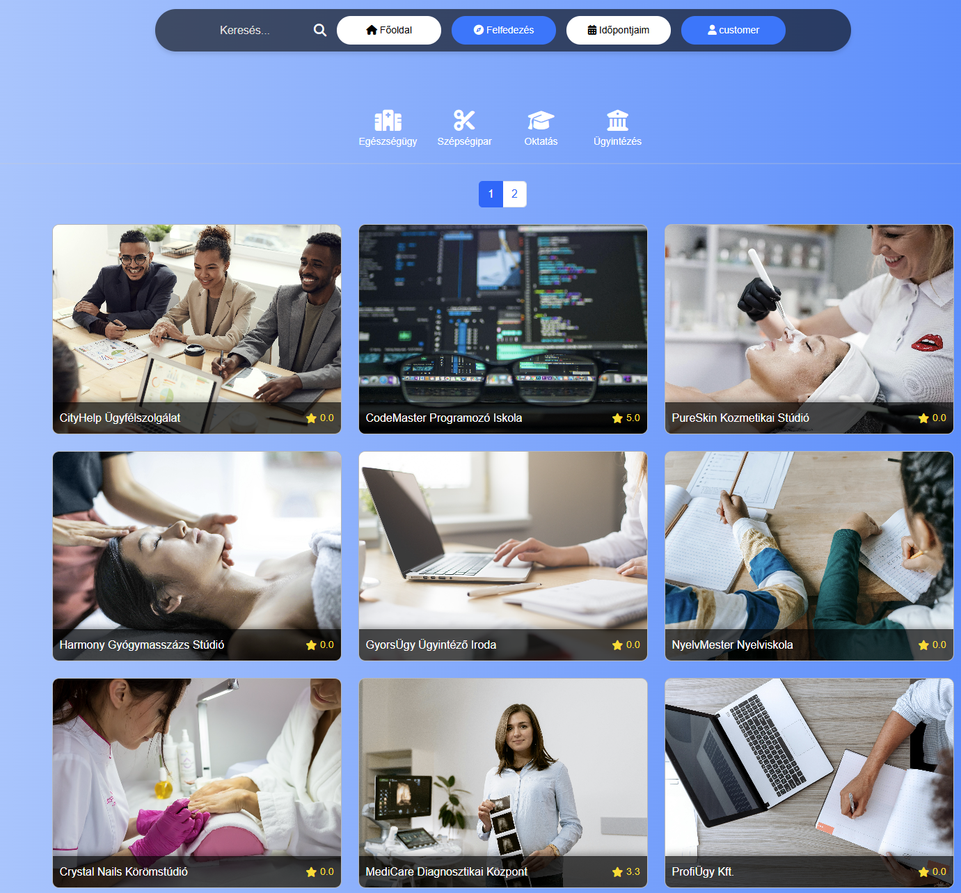
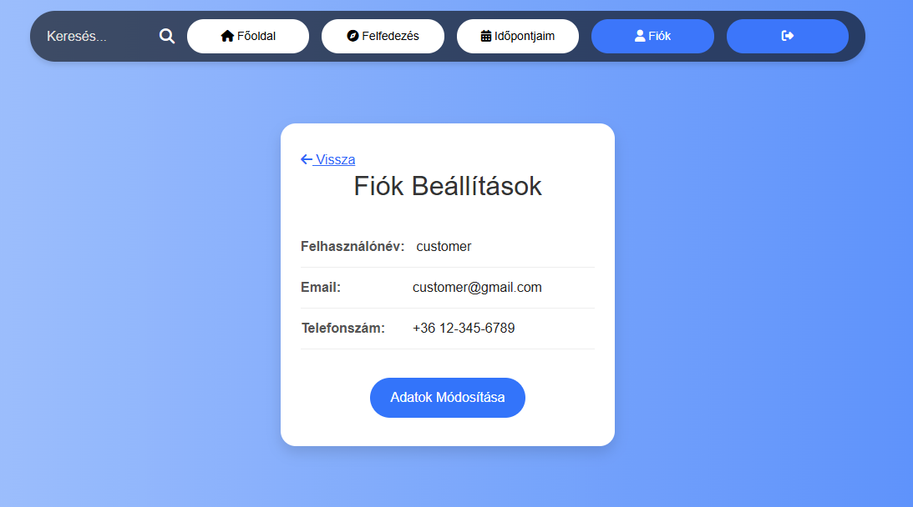
Finished Webpage

Slide 6
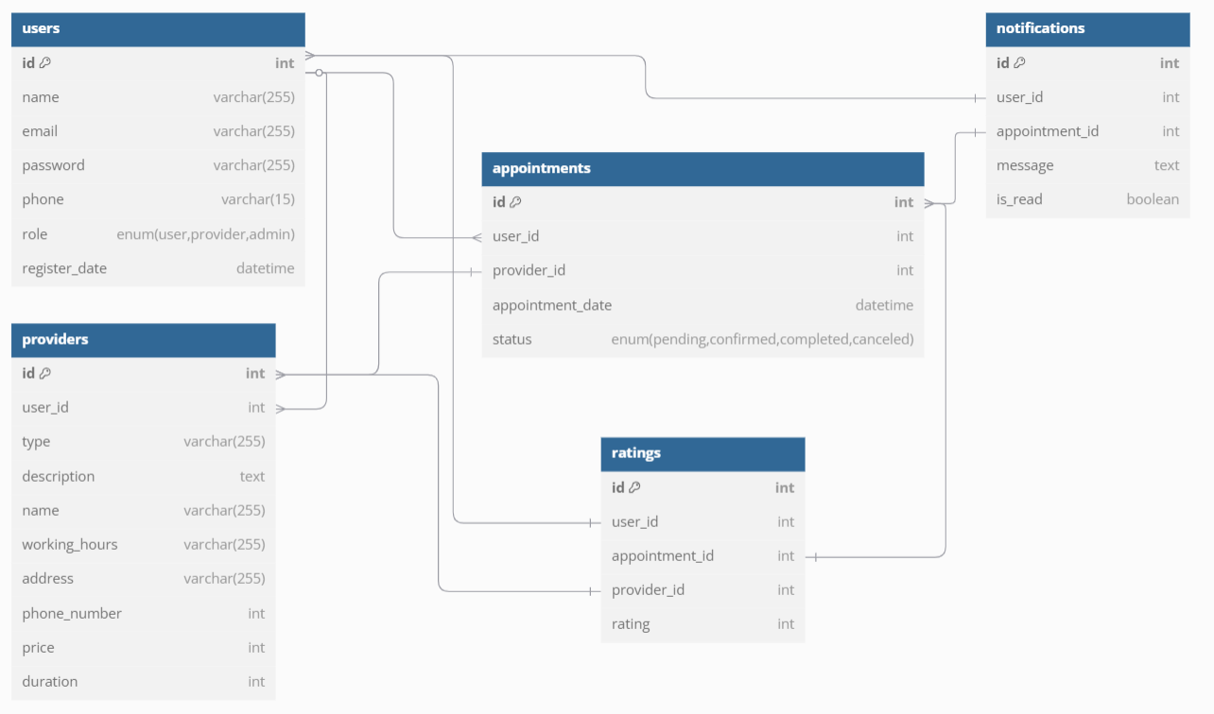
Database Plan
Notes:
Database Structure This system allows users to book appointments with service providers, receive notifications, and leave reviews. Below are the main tables and their relationships.
Users The users table stores data for all registered users (user, provider, admin). Each user has a role that determines their permissions.
Providers The providers table contains information about service providers, such as the service type, working hours, address, phone number, price, and service duration. Each provider is linked to a user account through the user_id field. Appointments The appointments table connects users and service providers. It stores: The date and time of the appointment, The user and provider IDs, The appointment status (pending, confirmed, completed, canceled). Notifications The notifications table stores messages sent by the system, such as: Booking confirmations, Reminders, Updates or cancellations. Ratings Users can rate service providers after an appointment. The ratings table stores scores from 1 to 5 stars.

Slide 7





Technology Stack
Frontend:
HTML
JavaScript
CSS
Bootstrap
Backend:
PHP
MySQL
Development Environment:
Visual Studio Code
MAMP local server
Notes:
-PHP: The reason we chose it, is because of it’s easy integration with MYSQL, built in session handling for user authentication, and for it’s wide community support and documentation. -MYSQL: We chose it for it’s reliable database system, great performance with PHP, and because it supports complex query support for our appointments and ratings. -JAVASCRIPT: Was chosen because of its dynamic user interactions, AJAX calls for bookings, and form validations. -------------AJAX - frissíti az oldal tulajdonságait, f5 nélkül[It updates the webpage without having to refresh. -CSS/BOOTSTRAP: We needed it for it’s responsive designs, professional UI elements, and cross-browser compatibility.

Slide 8
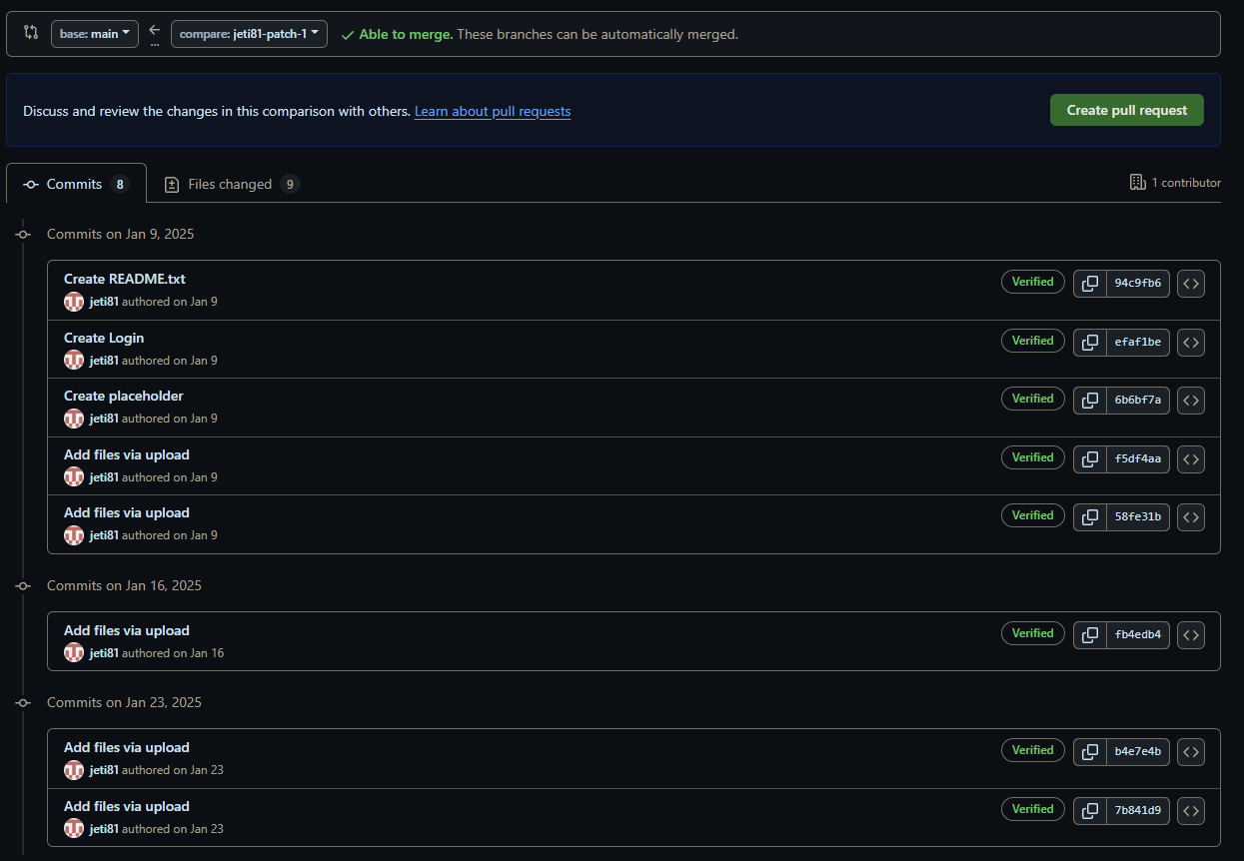
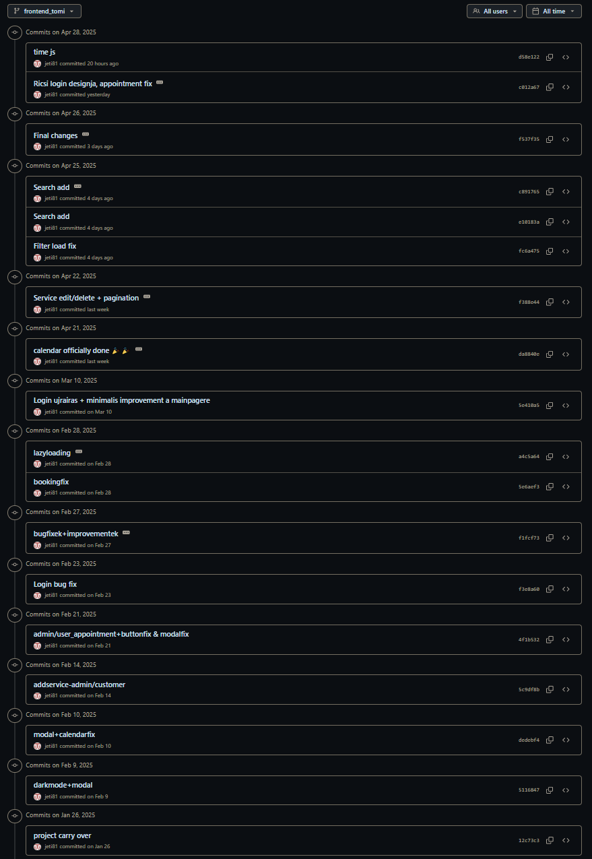
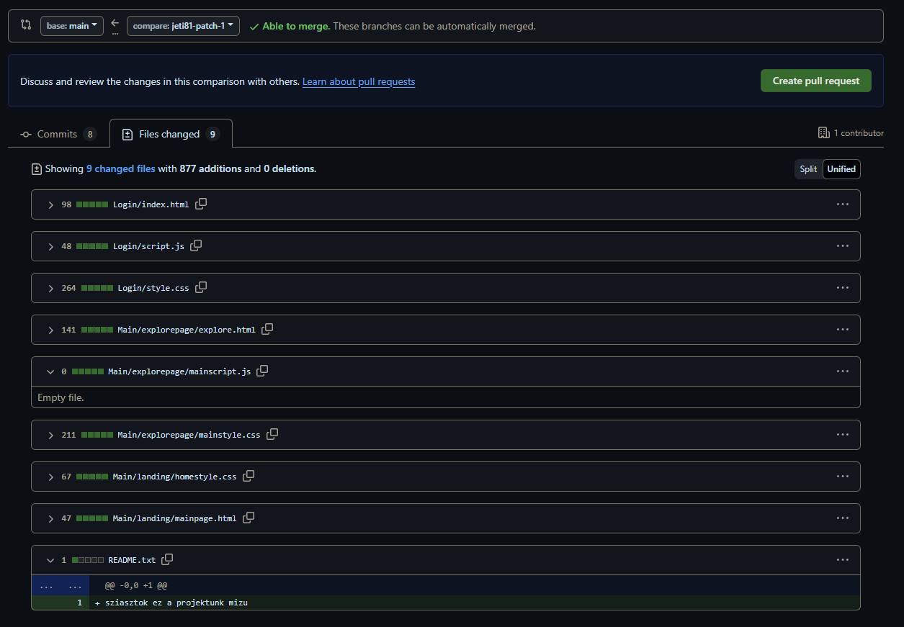
Tamás Git Workflow
Notes:
Here, you can see what Tamás has been working on, he’s been mostly working on the frontend side, but later joined in the backend development as well. Excuse us if this isn’t really readable, and is all over the place, but we are still somewhat in the learning phase (féz) of how to use github.

Slide 9
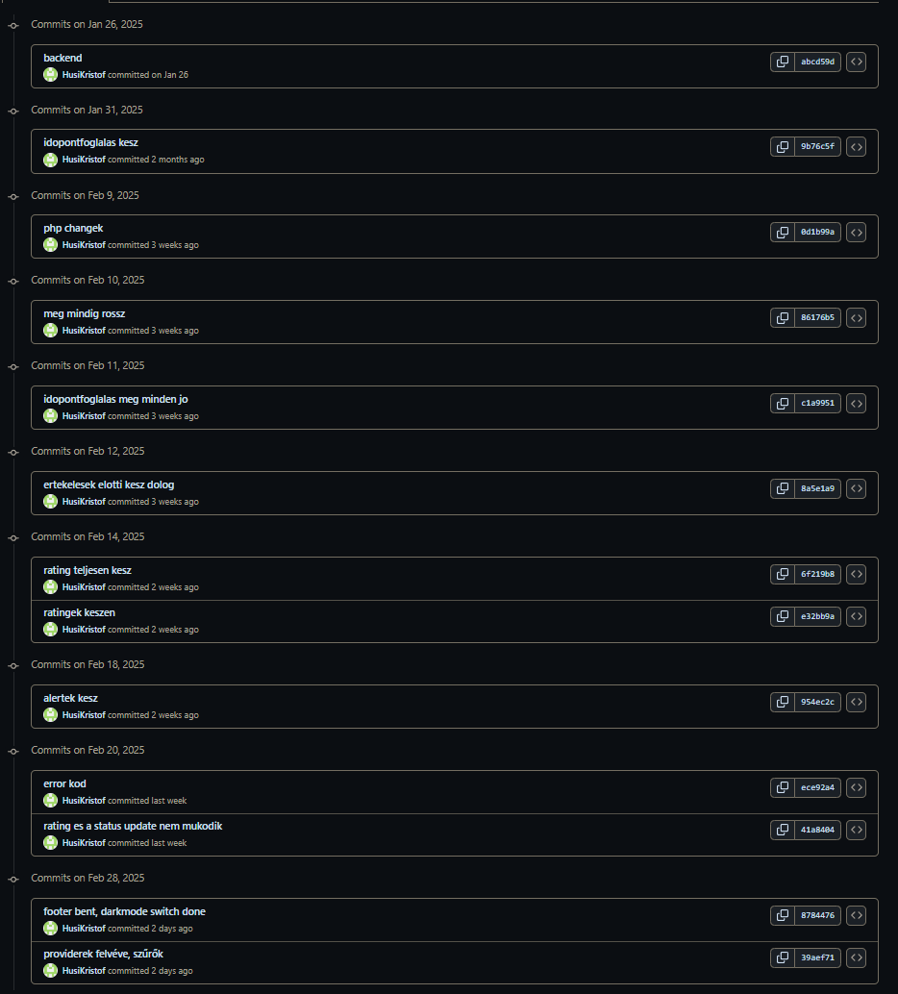
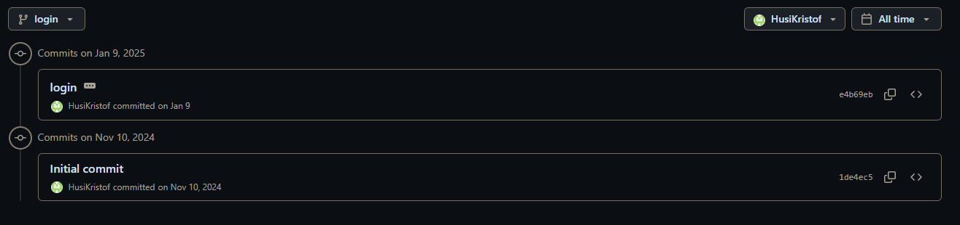
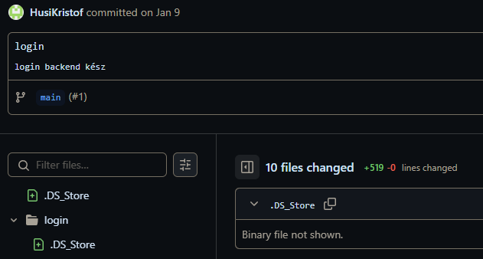

Kristóf Git Workflow
Notes:
This is what I’ve been working on, I’ve been working on the backend, mostly PHP, but also helped out in some javascript development.

Slide 10
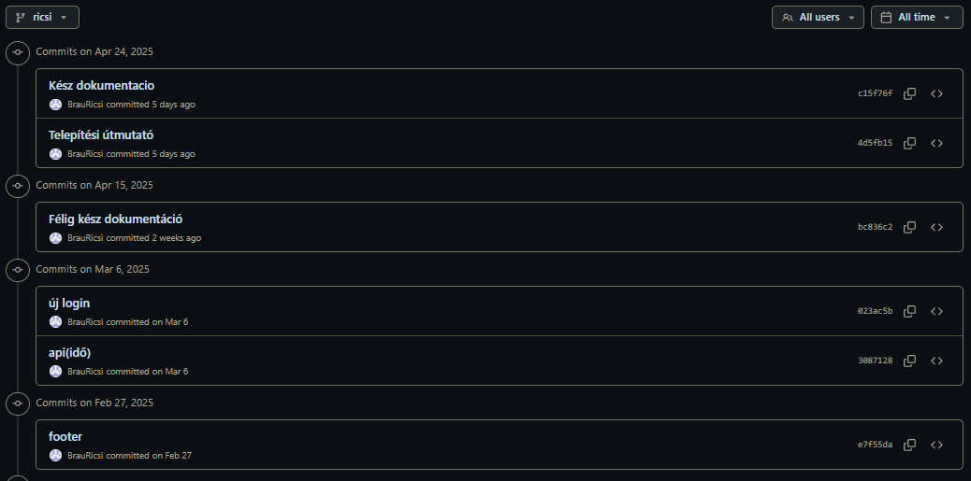
Ricsi Git Workflow

Slide 11
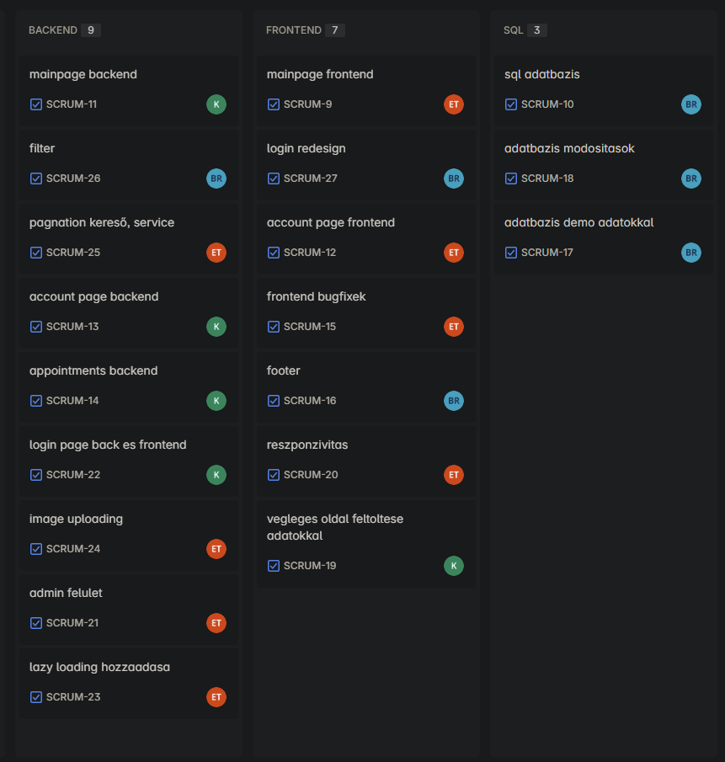
Jira work share

Slide 12
Potential Future Improvements
Online Payment
Ad support
Expand To Foreign Countries
Customer Service
Mobile App
Notes:
There would be some improvements if we would have the time and resources, like adding online payment, adding ad support, epxanding to foreign countries, adding a customer service, and developing a mobile application.

Slide 13


Summary
Online Appointment Booking – simple, fast, and accessible 24/7.
User Profile Management – for both clients and service providers.
Booking Rules – set availability and maximum bookings.
Automated Notifications – confirmations, reminders, and cancellation alerts via email.
Online Payments – support for credit card payment options .
Multi-Language & Time Zone Support – for global accessibility.
Notes:
We are very happy on how this has turned out, there are some things which we couldnt really finish due to the limited time we had, but overall, everything that we imagined is implemented, and is (mostly) working!

Slide 14
Thank You! For Your Attention
Notes:
We would like to thank everybody today for listening to our presentation, we really hope you liked the project that we have been working on! If there are any questions, feel free to ask them, and have a great day!

